Slide 1
GOODCABS Secondary Analysis

Slide 2
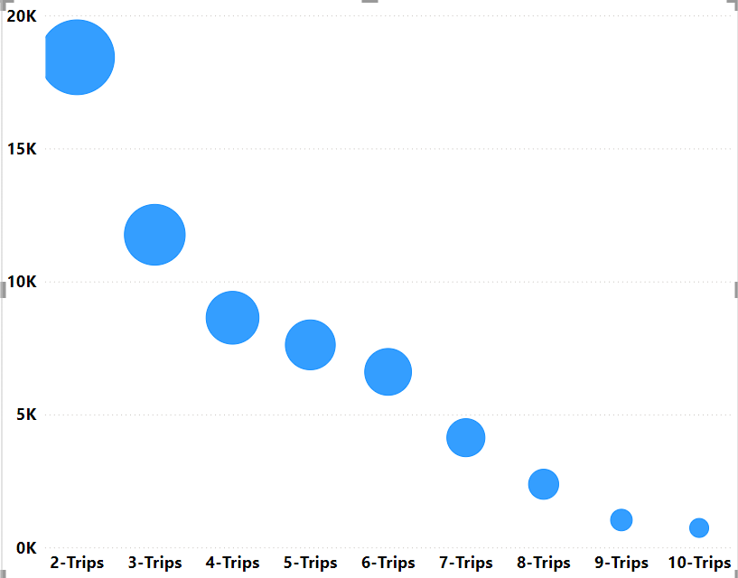
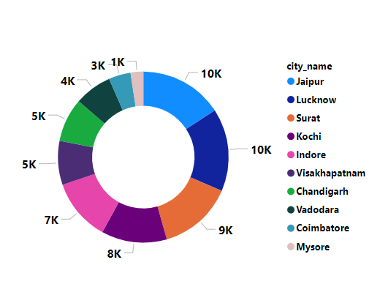
Repeat Passenger Rate
Highest Repeat Passenger rate is from 2 trips that is around 18k
Jaipur, Lucknow and Surat cities has the highest repeat passenger rate.
Mysore has the lowest repeat passenger rate

Slide 3
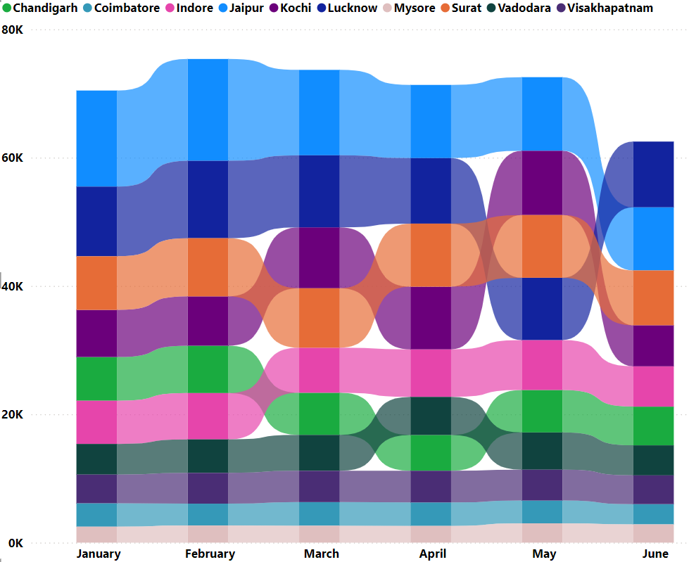
Tourism and Business Demand
1.Jaipur city which is famous for its palaces and forts has demand for Good cabs in every month.
2. Multicultural city Lucknow has high demand for cabs in the months of January, February, March, April.
3. Malabar coast of India Kochi has high demand for cabs in May.
4. Textile hub and trading port
City Surat has high demand for cabs almost in every month

Slide 4
The zero emissions of electric cabs mean that they don't release poisonous pollutants that cause serious respiratory illnesses and even death. This makes them safer for the health of cab owners, drivers, customers, and the public at large
Electric vehicles are well suited as cabs due to the low running cost. Upfront buying of cars may need huge capital but EVs cost on average only 25% of ICE running costs. so if you can manage capital, EVs are a good option.
3.Emerging Mobility Trends and Good Cabs Adaptation

Slide 5
Partnership with Local business
Hotels: Partnering with hotel chains to give riders a bit more incentive to choose the ride-hailing service over a taxi
Airlines : Partnering with Airlines to make it easier for passengers to book onward travel via the carrier's app and simplify the door-to-door travel experience.
Airport : Partnering with airports and have specific waiting areas for riders for pickup and drop off to reduce wait time
HealthCare : Partnering with Healthcare companies and helping healthcare worker commute to work and free up parking spaces for patients by subsiding rides to and from the office.
Leverage Uber Health for same-day deliveries of prescriptions and medical supplies.
Rail Operators :Partnering with Rail operators making it easier for passengers to get from station to destination.
Shopping malls: To have designated drop off and pick up at shopping centers.
Student and Faculty: Partnering with colleges and universities to meet the unique needs of college and university students and faculty. to meet the unique needs of college and university students and faculty.

Slide 6
Data Collection
Monthly Active Users
Average Revenue per active rider
Market share

